Slide 1
Ergonomics Prevention

Slide 2
Why?
60-90% of surgeons report pain or discomfort during or after surgery
Leads to work-related injury and musculoskeletal disorders

Slide 3
Principles

Slide 4
Positioning
During lifting/moving, position yourself as close to patient as possible
Face the work area when performing tasks
  Avoid working with neck flexed more than 30 degrees or rotated for >1 minute
Avoid reaching behind your shoulders
Van Veelen. Surg Endo and Oth Int Tech 2003.

Slide 5
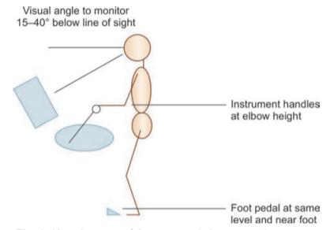
Height of operating table
Adjust for tallest surgeon
  May not be the attending
  Shorter people should use steps
    Steps are only available at fixed heights - may cause issues
Open surgery: angle of elbow joint should be 90-120 degrees
Laparoscopy: instrument handles should be close to surgeons’ elbow level (64-77 cm above floor)
Yeola. Int J Recent Surg Med Sci 2017.
Berquer. Surg Endo and Oth Int Tech 2002.

Slide 6
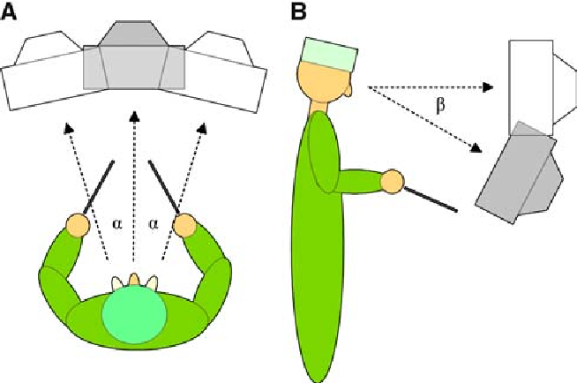
Monitors
Horizontal plane:
  Straight in front of you
  Align with forearm-instrument motor axis to avoid axial spine rotation
Sagittal plane:
  10-20 degrees lower than eye level (i.e., top of screen at eye level) to avoid over-extension or flexion
Van Det. Surg Endo 2009.
Yeola. Int J Recent Surg Med Sci 2017.
Albayrak. 2008.
Ronstrom. Surgeons as Educators 2018.

Slide 7
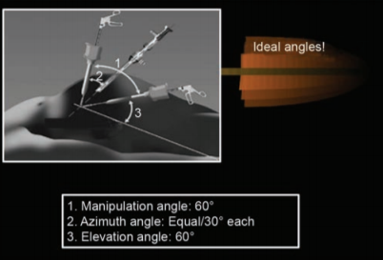
Ports
Ideal manipulation angle 45-75 degrees with equal azimuth angles
Target organ 15-20 min from optical trocar
Triangulate with 2 remaining trocars in same 15-20 cm arc at 5-7 cm on either side of optical trocar (s)
Foot pedals
  Near foot
  Align with instruments (toward target organ + monitor)
  On a step if surgeon on a step
Yeola. Int J Recent Surg Med Sci 2017.
Van Veelen. Surg Endo and Oth Int Tech 2003.

Slide 8
Ergonomic equipment
Footrests – Prop alternating feet up to decrease static posture
Sit/stand stools
  Sit when case allows. Alternating sitting + standing increases blood flow and distributes load on different parts of body
  Place stools at height allowing surgeons to look straight ahead
Lead
  2 pieces aprons
  Minimize wearing time
  Consider portable lead shield instead of apron
Van Veelen. Surg Endo and Oth Int Tech 2003.

Slide 9
Ergonomic equipment
Anti-fatigue mats
  Holes on top or foam bottom
  Cause slight postural sway inducing minor activation of leg muscles
  Tapered slides to avoid tripping
  Anti-skid coating to avoid slipping
  Anti-slip mats are NOT necessarily anti-fatigue
  Avoid thick cushioning – too much instability increases muscle demand
Anti-fatigue footwear
Van Veelen. Surg Endo and Oth Int Tech 2003.

Slide 10
Exercises

Slide 11
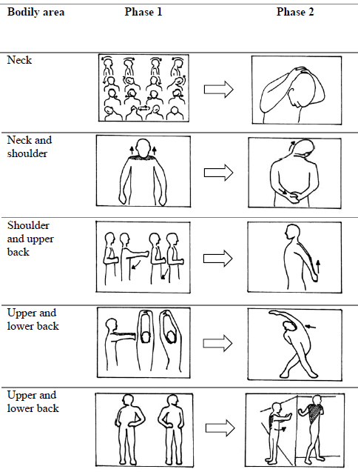
Exercises
Extra-working physical activity is protective
Perform 5 minutes before and after procedure
Phase 1 = nonresistance active exercises (perform 10x)
Phase 2 = static stretching (hold >20 seconds each)
Giago. Ann Surg 2019.

Slide 12
OR-Stretch (Mayo)
Perform slowly with no rapid or forceful movements
Keep breathing relaxed throughout
If activity causes discomfort, stop
Video at: https://youtu.be/bLAeVbBjZV0
OR-Stretch

Slide 13
Hamstring Stretch
OR-Stretch
Notes:
• Sit forward on the front part of your chair and sit as tall as you can.
• Extend one leg out in front of you with your knees straight and your heel on the floor.
• Lean forward from your hips as far as you can while maintaining the upright posture.
• Hold for 30-60 seconds.
• Return to sitting tall and repeat on the other side.

Slide 14
Seated Trunk Extension & Flexion
OR-Stretch
Notes:
• Sit forward on the front part of your chair and sit as tall as you can.
• Place your hands on your iliac crests.
• Take a deep breath lifting your chest upwards.
• Tilt your pelvis gently forward bringing your belly button toward your knees. Arch (extend) your back
gently using your hands as a focus point for the arch.
• As you exhale, gently curl your pelvis and ribs toward one another around your hands and waist and flex
your spine.
• Hold each position for 10 seconds, repeat each exercise 2-3 times and return to the upright position.

Slide 15
Shoulder Shrugs
OR-Stretch
Notes:
• Sit forward on the front part of your chair and sit as tall as you can.
• Shrug your shoulders up and roll them back and down, lifting your chest and pinching your shoulder
blades together.
• Hold for 10 seconds, take a deep breath and relax.
• Repeat the exercise 2-3 times.

Slide 16
Neck Extension & Flexion
OR-Stretch
Notes:
• Sit forward on the front part of your chair and sit as tall as you can.
• Extend your neck by lifting your face toward the ceiling dropping your head back as far as you
comfortably can.
• Tuck your chin and curl forward stretching the upper part of your neck and continue curling downward
by flexing your lower neck and thoracic spine as far as you comfortably can.
• Hold for 10 seconds, and repeat each exercise for a total of 2-3 times.
• In between each stretch, relax and return to sitting tall.

Slide 17
Seated Trunk Rotation
OR-Stretch
Notes:
• Sit forward on the front part of your chair and sit as tall as you can.
• Turn your head looking over your left shoulder as you comfortably can.
• Continue rotating with your shoulders and trunk while lengthening the muscles in your back and spine.
• Hold for 10 seconds and then relax and return to the upright position in midline.
• Repeat each exercise to the left and right for a total of 2-3 times each side.

Slide 18
Trunk Rotation with Hip Stretch
OR-Stretch
Notes:
• Sit forward on the front part of your chair and sit as tall as you can.
• Cross the left ankle over the right thigh.
• Turn your trunk to the left and place your right hand over your left knee.
• Gently pull your left knee to the right as you turn your trunk further to the left.
• Hold for 10 seconds, then relax, uncross your legs, and return to sitting in the upright position.
• Repeat the exercise on the right, and repeat each exercise for a total of 2-3 times.

Slide 19
Seated Lateral Trunk Rotation
OR-Stretch
Notes:
• Sit forward on the front part of your chair and sit as tall as you can.
• Reach your left arm over your head placing your hand on your head with your palm facing up toward the
ceiling.
• Take a deep breath in, side bend to the right and reach your elbow toward the ceiling.
• Relax and release your breath as you return to the upright position.
• Alternate position: If you cannot put your hand on your head, you have shoulder pain, or if the former
exercise is painful, put the back of your hand on the front of your shoulder and side bend without
stressing your shoulder.
• Repeat the exercise 2-3 times on each side, holding each position for approximately 10 seconds.

Slide 20
Shoulder Extension with Neural Tension
OR-Stretch
Notes:
• Sit forward on the front part of your chair and sit as tall as you can.
• With your elbow and fingers completely straight, flex your wrists as far as you comfortably can while
keeping your fingers fully extended.
• Extend your shoulder back as far as you comfortably can.
• Hold for 10 seconds, relax and return to the neutral position.
• Repeat the position on the opposite side and complete each exercise for a total of 2-3 repetitions.

Slide 21
Shoulder Flexion with Neural Tension
OR-Stretch
Notes:
• Sit forward on the front part of your chair and sit as tall as you can.
• With your elbows straight, extend both wrists as far as you comfortably can while keeping your fingers
straight.
• Reach both arms overhead and take a deep breath in as you push your hands away from your body as
far as you comfortably can while keeping your wrists and fingers extended.
• Keep pushing your hands away from your body and return your arms back down to your sides while
exhaling and relaxing.
• Hold the position for 10 seconds and repeat 2-3 times.

