Slide 1
Session 3 Overview
Today’s skill
  Mindfulness

Slide 2
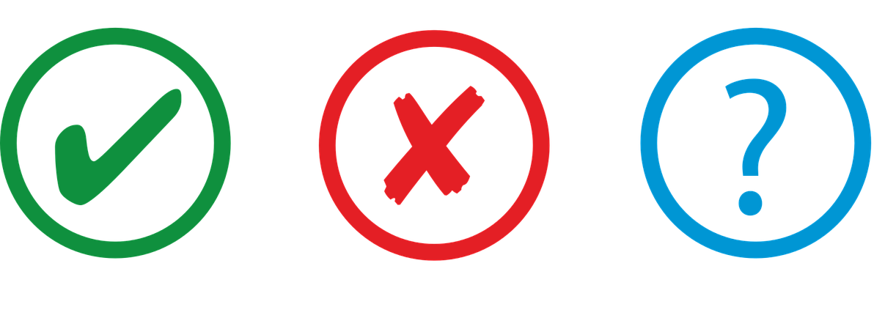
Mindfulness
Notes:
Who has experience with mindfulness? Who practices regularly? Who’s tried it and didn’t like it? What’s your understanding of what mindfulness is?

Slide 3
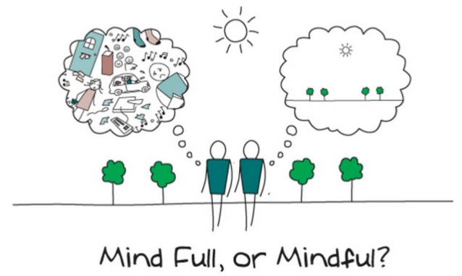
Mindfulness
Notes:
Mindfulness is a practice that is part of our coping skills toolbox, and you'll see that mindfulness really underlies many of the other skills that we have talked about. Mindfulness practices allow us to train our attention to be more focused on the present moment.
What’s great about mindfulness is that it can be used anywhere, it does not require any equipment, it doesn’t take more than a minute, sometimes you just need 30 seconds, and you can use it throughout the entire day. So what is mindfulness?

Slide 4
Mindlessness
What mindfulness is not
Notes:
Sometimes it’s easier to understand what mindfulness is by describing what it’s not. “Mindlessness,” is the opposite of mindfulness.

Slide 5

Notes:
For example, have you ever sat down to eat a meal and realized at the end of the meal that you forgot to enjoy your food, or even notice how it tasted? Instead you just shoveled food into your mouth in a zombie-like fashion.

Slide 6

Notes:
Or how many of you have been talking to someone, and realized you were distracted by other thoughts and missed what the other person was saying?

Slide 7
Mindlessness is Common
On average, our minds are “lost in thought” approximately 47% of the time
(Killingsworth & Gilbert, 2010, Science)
Notes:
This type of mindlessness is common. One study from Harvard found that on average, our minds tend to be “lost in thought” approximately 47% of the time.

Slide 8
Breaking the Cycle
Paying Attention to the Present Moment
Lost in thought
Distracted
Overwhelmed by difficult emotions
Notes:
So how do we break the cycle away from being lost in thought, distracted, or overwhelmed by difficult emotion and learn to be in the here and now and pay attention to the present moment?

Slide 9
Retraining Our Attention
Notes:
Today we will be talking about a skill that allows us to consciously retrain our attention – called mindfulness.

Slide 10
Mindfulness
Paying attention, on purpose, in the present moment, with an accepting and non-judgmental attitude
Notes:
Mindfulness can be defined as paying attention, on purpose, in the present moment, with an accepting and non-judgmental attitude. So let’s break down each of these different facets of mindfulness.

Slide 11
Paying Attention
Noticing and attending to :
  Internal experiences
    Thoughts
    Feelings
    Physical sensations
  External World
    Sights
    Sounds
Notes:
First, mindfulness involves paying attention. That is, noticing and attending to our internal experiences, such as our thoughts, feelings, and physical sensations, as well as our external world: such as the sights and sounds of things going on around us.

Slide 12
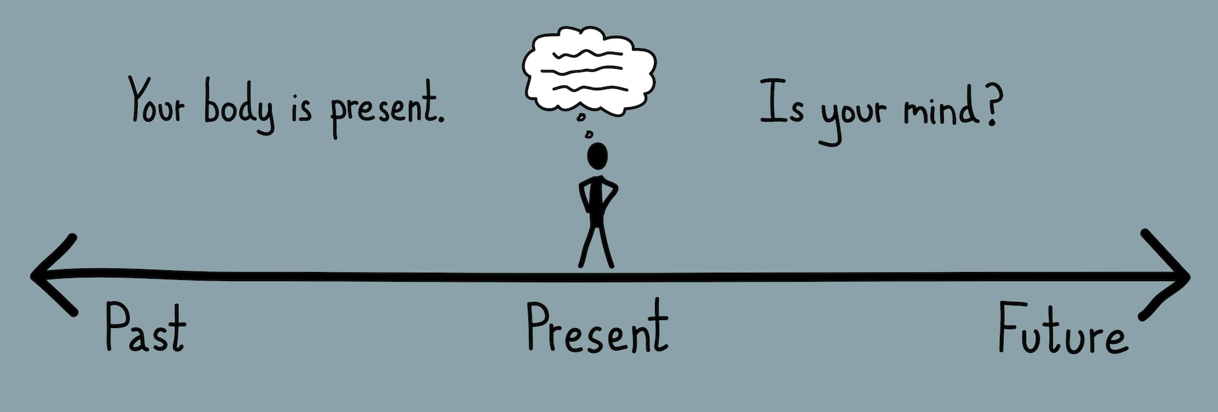
Being in the Present Moment
Focus our attention on the present moment, instead of dwelling on the past or planning/worrying about the future
Being present allows us to make choices and respond, rather than react to situations
Notes:
In addition, mindfulness involves learning to focus our attention on the present moment, instead of dwelling on the past or planning our next action or worrying about the future.
Often, when we live our lives on autopilot, we can start to feel like we’re just passively reacting to the things going on around us. We might start to feel as if we’re not actually living our lives and that we don’t have a role in shaping or changing the events going on around us. Being in present is important, because it allows us to make choices and respond rather than react to situations.

Slide 13
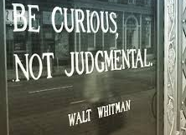
Non-judging and Accepting Attitude
Being aware of your thoughts/feelings
  Without evaluation or critique
  Without trying to change the situation or your experience
Helps distinguish between the experience itself and the thoughts we have about it
Notes:
In addition to present-focused attention, adopting a non-judgmental and accepting attitude is key to mindfulness. Mindfulness involves training yourself to be aware of your thoughts and feelings, without evaluating or critiquing them. It is a process of allowing thoughts and feelings to come and go without trying to change or manipulate the situation or your experience. Bringing non-judgmental awareness to an experience can help us learn to distinguish between the experience itself and the thoughts we have about it.

Slide 14
Acceptance ≠ Resignation
Accepting a situation doesn’t mean you’re giving up
Resignation involves making predictions about the future
Mindfulness is about accepting the present moment
Notes:
One important distinction to note is that when we talk about "acceptance” in mindfulness, we don’t mean resignation. That is, accepting a situation doesn't mean you're giving up or that you’re going to stop taking action to change the things in your life that you can or should change. For example, if you do poorly at something, for instance doing poorly on an exam, you might respond a thought like “I should just accept that I’m not good enough to be in medicine and I’ll never be a good doctor.” This isn’t acceptance, this is resignation. Resignation involves making predictions about the future, whereas mindfulness is about accepting what is happening in the present moment. Nothing more, nothing less. It means saying "I did badly at that. I'm feeling very disappointed."

Slide 15
Benefits of Mindfulness
More positive emotion and less negative emotion
  Less anxiety, depression, stress, burnout, PTSD
  Better quality of life
Increased awareness can help you appreciate the good things you might have missed or overlooked
Stops repetitive/ruminative thinking
Notes:
There’s now a wealth of research that highlights the benefits of mindfulness for our well-being. For instance, people who are mindful in their daily lives tend to have more positive emotion and less negative emotion. This may be because practicing mindfulness can make you more aware, and this increased awareness can help you appreciate the good things going on around you that you might have otherwise missed or overlooked.
Mindfulness can also stop repetitive or ruminative thinking. Mindfulness can help you notice and let go of repetitive thoughts, by helping us recognize our habitual thoughts and behaviors, and breaking unhealthy cycles or patterns of behaviors.

Slide 16
Benefits of Mindfulness for Physicians
Krasner et al. (2009) JAMA
  70 primary care physicians
  Mindfulness intervention
  8-week intervention for 2.5hrs/week
Notes:
For example, Krasner and colleagues conducted a study evaluating the impact of a 8-week mindfulness intervention in 70 primary care physicians.

Slide 17
Results: Krasner et al. (2009) JAMA
**
***
***
***
***
***
***
***
***
***
***
***
** and *** indicates significant change from baseline at p < .01 and p < .001
Notes:
In this study, Krasner and colleagues found that physicians who participated in the mindfulness intervention showed increased mindfulness and physician empathy and decreased mood disturbance and emotional exhaustion, and these benefits persisted over a year.

Slide 18
Practicing Mindfulness
Mindful moments in daily life (informal practice)
Meditation (formal practice)
Notes:
Now let’s talk about how we can practice mindfulness. That is, how you can train ourselves to bring your awareness to the present moment anytime and anywhere. Mindfulness is learned and practiced in both formal and informal ways.

Slide 19
Informal Practice:
Incorporating Mindfulness in Daily Life
Notes:
The first way to practice mindfulness involves integrating small mindful moments into daily life. One great thing about mindfulness is that it can be practiced in almost any daily situation.

Slide 20

Taking a Mindful Break
Notes:
Mindful chocolate activity [see handout]
Notes to the facilitator: You will need small bars of chocolate enough for each member of the class. Alternatively, the students can take a piece of chocolate from a large bar. Please read each instruction one at a time before moving on to the next stage. Approach the exercise with an open mind and a gentle curiosity. There are no rights or wrongs, just individual experiences.
Read the following script aloud to lead the activity:
Consider the wrapped chocolate -
Does the wrapper make a sound? What color is it? What does it say? Where did it come from?
Open the chocolate, slowly -
Do you feel a sense of anticipation, or an urge to immediately put the chocolate in your mouth? What physical
sensations do you have? What emotions are you feeling? Just note them.
Look at the chocolate-
Consider its texture, color, weight…
Smell the chocolate - does the smell trigger any other senses?
Where do you feel your sense of smell?
Place the chocolate in your mouth but DO NOT EAT!!
How does it feel as it melts?
Where in your mouth can you taste it?
What is the consistency?
What is happening with your mouth, teeth, tongue, lips as it melts?
Move the chocolate around your mouth
Does the area of taste change?
Does the taste itself change?
What is happening to the chocolate?
How do you feel?
Swallow the chocolate, focusing on the sensation.
Is there a lingering taste?
How do you feel physically and emotionally?
Take a little while to consider the experience.

Slide 21
Group Discussion
How was this different from your general chocolate-eating experiences?
  More intense? Frustrating? More pleasurable?
Were you more aware of your emotions during the exercise?
Would this change your future experience of eating chocolate?
  Why or why not?
Notes:
How was this different from your general chocolate-eating experiences?
More intense? Frustrating? More pleasurable?
Were you more aware of your emotions during the exercise?
Would this change your future experience of eating chocolate?
Why?

Slide 22
Mindful Moments in Everyday Activities
Brushing teeth
Eating
Chores – e.g., washing dishes, folding laundry
As you go through these activities
  Slow down
  Take a breath
  Engage your senses
  Pay attention to the task
Notes:
You can incorporate mindful moments in your everyday activities, such as brushing your teeth, eating, or doing chores. As you go through these everyday activities, you can choose to slow down, engage your senses (like thinking about the physical sensations of what you’re doing, the smell, the colors and textures, your posture), and pay attention to the actual task.

Slide 23
Handout on Ways You can Incorporate Small Mindful Moments in Daily Life
(“Practical Mindfulness”)
Notes:
Here is a handout that provides different examples for incorporating small mindful moments in daily life. Some people think of this as “practical mindfulness”.

Slide 24


Mindful Moments in Medicine
In medicine
  Washing hands
  Before entering patients’ room
Notes:
In medicine, it can be helpful to take a mindful moment to clear your head as you’re doing certain activities, like washing your hands, or before entering a patients’ room. Most of the time, doctors tend to be “lost in their thoughts” during these activities, thinking about the next thing on their to-do list, or thinking about what just happened. Instead, you can choose to be in the moment:
Slow down and pay attention to the actual task. For instance, if you’re washing your hands before a procedure- you may take a moment to notice the feeling of warm water on your hands, the scent of the soap, your posture, and the movement of your hands.
Some doctors find it to be beneficial to take a mindful moment to clear their minds right before entering a patients’ rooms, and they may use the doorknob as a cue to take a mindful moment. As you’re reaching for the doorknob, you can take a deep breath, notice the air flowing through your nose as you breathe in, feel the cold of the air in your nostrils, hold the breathe for a few seconds, and then breathe out through your mouth. This quick act of breathing in through your nose, holding, and breathing out through your mouth, can serve as a nice way to clear your mind of what’s going on outside, and so that you can enter your patients’ room with a clean slate.

Slide 25
Formal Practice:
Meditation
“Attention Training”
Notes:
Just like how you might integrate exercise in your daily life formally by going to the gym and lifting weights, meditation allows us to practice mindfulness formally by sitting still and practice being aware and present in the moment, without doing anything else for a dedicated amount of time. Think of meditation as “attention training.” And attention training helps our ability to be present.

Slide 26

Let’s try it
Notes:
Now we are going to spend the next 5 minutes going through a guided mindfulness meditation. For this kind of practice, it’s best to find a posture that allows you to be comfortable and relaxed but also alert.
Do your best to follow the verbal instructions, but don’t worry if you find your mind wandering - that's normal and expected! One common misunderstanding is that meditation is about "clearing your mind." Everyone’s mind wanders; that’s what our minds naturally do. The practice is not to "clear your mind" but to notice that your mind has wandered, and when you do, just gently bring your attention back to your breath. This will likely happen many, many times in 5 minutes!
Do your best to not judge yourself or get frustrated…remember, the point is not to have a mind empty of thoughts. The point of the exercise is to get better and better at noticing you’ve wandered and then gently and kindly bringing your focus back to your breath.
Do you have any questions?
Loving Kindness Meditation (script in folder) – can also do breath awareness meditation or alternate meditation.
In this meditation on lovingkindness, allow yourself to switch from the usual mode of doing to a mode of non-doing. Of simply being. As your body becomes still, bring your attention to the fact that you are breathing. And become aware of the movement of your breath as it comes into your body and as it leaves your body. Not manipulating the breath in any way or trying to change it. Simply being aware of it and of the feelings associated with breathing. And observing the breath deep down in your belly. Feeling the abdomen as it expands gently on the inbreath, and as it falls back towards your spine on the outbreath. Being totally here in each moment with each breath. Not trying to do anything, not trying to get any place, simply being with your breath. Giving full care and attention to each inbreath and to each outbreath. As they follow one after the other in a never ending cycle and flow. If distracting thoughts arise, acknowledge them, then return to the practice.
And now bringing to mind someone for whom you have deep feelings of love. Seeing or sensing this person and noticing your feelings for them arise in your body. It may be simply a smile that spreads across your face, or your chest becomes warm. Whatever the effects, allow them to be felt.
Now letting go of this person in your imagination, and keeping in awareness the feelings that have arisen.
Bring yourself to mind now. And seeing if you can offer lovingkindness to yourself, by letting these words become your words…
May I be happy
May I be healthy
May I ride the waves of my life
May I live in peace
No matter what I am given
And noticing the feelings that arise and letting them be, as you look within yourself with mindfulness and equanimity.
When you are comfortable, try offering lovingkindess to someone who supports you, who has always "been on your side." Bringing this person to mind, imagining them perhaps across from you, and letting these words become your words…
May you be happy
May you be healthy
May you ride the waves of your life
May you live in peace
No matter what you are given
Once your feelings flow easily to a loved one, turn your attention now to someone with whom you have difficulty - it’s best not to start with the most difficult person, but perhaps someone who brings up feelings or irritation or annoyance. And seeing if you can let these words become your words as you keep this person in awareness…
May you be happy
May you be healthy
May you ride the waves of your life
May you live in peace
No matter what you are given
Notice the sensations and feelings that arise within you. And seeing if you can just allow them and let them be.
And now bringing to mind the broader community of which you are a part. You might imagine your family, your workmates, your neighbors, or fan out your attention until you include all persons and creatures on the planet. And including yourself in this offering of lovingkindness, as you let these words become your words…
May we be happy
May we be healthy
May we ride the waves of our lives
May we live in peace
No matter what we are given
Notice the sensations and feelings that arise within you. Sitting with them for a few moments until you are ready to end the practice.

Slide 27
Group Discussion
How was that for you? What was it like for you to practice noticing your thoughts and feelings as they distracted you
Notes:
How was that for you? What was it like for you to practice noticing your thoughts and feelings as they distracted you? Like any skill, this will indeed get easier with practice.
When we set an intention to be more fully in the present moment, we may also find that we become more aware of the many, many thoughts and emotions that are constantly arising for us.
If we try to forcefully push our thoughts and feelings away/out of our minds, they tend to become stronger and can take up even more of our attention.
Instead, we can practice just simply noticing that they are there--without feeling like we have to DO anything about them.
Thoughts will often remain in the background, but we can practice just letting them be there and return our attention to the breath instead.

Slide 28
Formal Practice: Meditation
Can formally practice meditation through guided meditations you can access online:
  Apps:
    Headspace, 10% happier, Cleveland Clinic has a Meditation App for Providers
Notes:
There are many different types that you can do to practice mindfulness. There are specific ones focused on mindfulness in medicine. There are some that involve affirmations. There are some for calming you down when you are feeling stressed that are really focused on your breath. Some of them are printed on the handout – one involves a task that’s called dropping an anchor which can help anchor or ground your attention in any present moment. There’s a meditation you can do that involves thinking of a color that you find particularly calming or soothing and doing a meditation in which you visualize that color run all through your body. These small activities can really be helpful in de-activating your stress response when you’re feeling heightened levels of stress, and just calming you down when you need it.

Slide 29
Mindfulness Practice:
Consistency > Quantity
Notes:
Consistency is more important than quantity when it comes to integrating these practices into your daily routine. Just like trying to integrate weight training in your daily routine, it might be beneficial to start with meditating over small chunks of time, and slowly increase the amount of time to dedicate to mindfulness as you grow stronger.

Slide 30
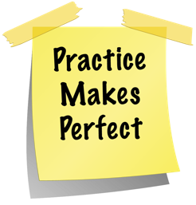
Home Practice
Mindfulness in Everyday Life
Mindfulness Meditation

Slide 31
Mindfulness in Everyday Life
Each day this week, try to find a task that you typically do on “autopilot” (such as driving, eating, washing the dishes) and then do that task mindfully -- paying close attention to whatever is happening in the moment. You can select something from the handout of examples of mindfulness in everyday life or choose a task of your own. Record the task and your experience each day.

Slide 32
Meditation Audio Recording
Spend 5-10 minutes listening to a meditation audio recording each day. The practice can be done at whatever time of day works best for your schedule, but it can be helpful to do it at the same time each day, in order to make it a routine. Do your best to find a quiet, comfortable place where you will not be disturbed. Practice noting your thoughts and feelings without reacting to them right away. As thoughts and feelings arise, do your best to just notice and accept that they are there without trying to change them.

Slide 33

Session 3 Feedback
Thoughts? Questions?
How might this skill be useful?
How could you incorporate this in your life?
Mindfulness
Notes:
How important is it to practice what you preach?
Activities?

